Slide 1
Group F: Milestone 2 Presentation
Andrew Ashley, Nur Iren, Sean McHale, Nayana Suvarna

Slide 2
Background & Previous Work

Slide 3


Project Goals
We predict that we can identify a correlation between overall sentiment in tweets and case count trends at different US cities by comparing sentiment in COVID-19 related tweets in the US to COVID-19 case data
We plan to build an application that leverages the model will scrape tweets related to Covid-19 from twitter, and then attempt to locate and display possible new Covid-19 hotspots
+
Notes:
Relevance to current issues + objective of project
Uncertain about application ---> will help predict hotspots

Slide 4
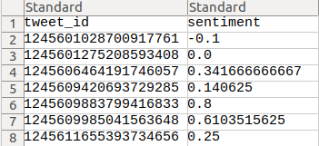
Geo-tagged Tweet Dataset
Tweet ID:
Each tweet is mapped to a unique key
Lookup of the key provides a JSON file with information about the tweets
Sentiment:
Score from sentiment analysis
Expressed on scale of [-1, 1]
https://ieee-dataport.org/open-access/coronavirus-covid-19-geo-tagged-tweets-dataset

Slide 5
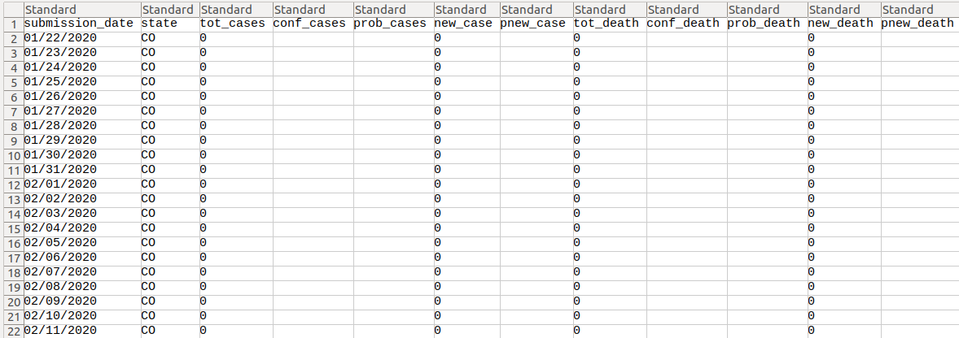
US Covid-19 Cases and Deaths by State
https://healthdata.gov/dataset/united-states-covid-19-cases-and-deaths-state-over-time
Notes:
Figure out through training which metric is best

Slide 6
Model: Regression
Mean Absolute Error (MAE)
The average absolute difference between the labels and predicted values. Values range from 0 to infinity, where a lower values indicate a higher quality model.
Root-Mean-Square Error (RMSE)
Measure of difference between the values predicted by the model and the values observed. Ranges from 0 to infinity, where a lower value indicates a higher quality model
RMSLE → RMSE in logarithmic scale
Coefficient of Determination (R^2) :
The square of the Pearson correlation coefficient between labels and predicted values. Ranges from 0 to 1, where a higher value indicates a higher quality model
Feature Importance
Relative importance of each feature, determined by how much the prediction varies when the value changes. Higher variance in the prediction indicates a greater importance

Slide 7
Approach 1: Data Setup

Slide 8
Data Setup: Daily Data
Cleaned up datasets and compiled data for each state on each date on:
Average sentiment, new cases, tweets, and new deaths
Average sentiment, new cases, and new deaths, tweets over next week
Standard deviation of sentiment, new cases, and new deaths over next week
Sum of new cases and new deaths over next week
Sentiment, new cases, and new deaths one week later
We used geotagged COVID tweets from 04/01/20 - 08/31/20 from our dataset

Slide 9
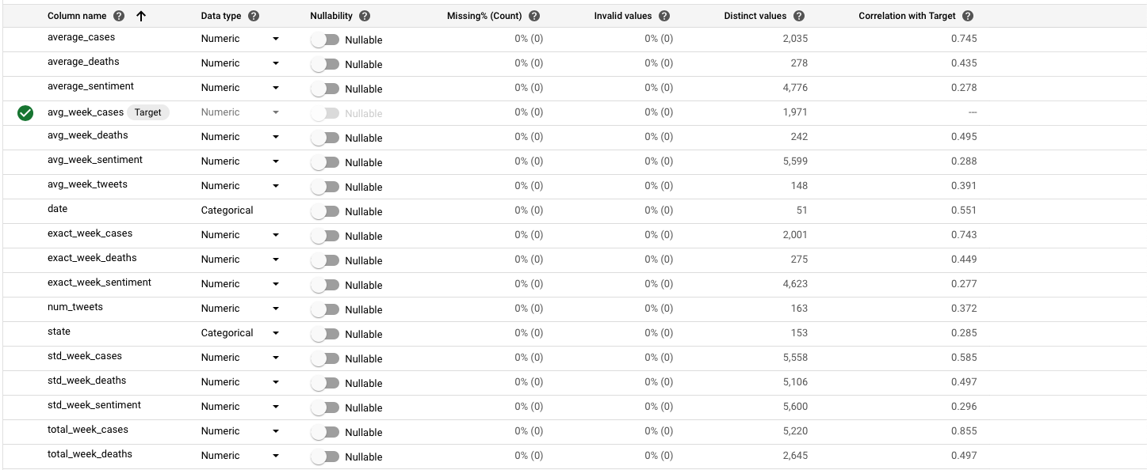
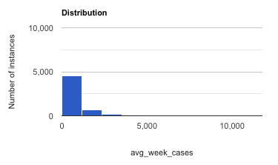
Prediction: Average number of new cases in the next week
Average = 939.53
Median = 511.5
Std = 1497.34

Slide 10
Approach 1: Training Results

Slide 11

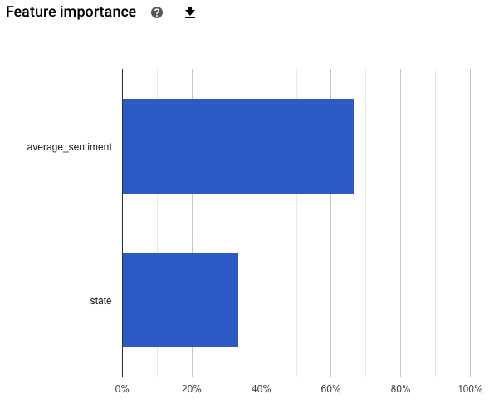
Attempting to Detect Patterns
Optimized for | RMSE
MAE | 809.046
RMSE | 1508.328
R^2 | 0.191

Slide 12
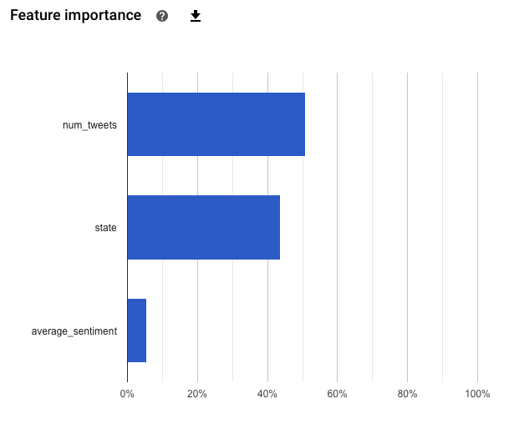
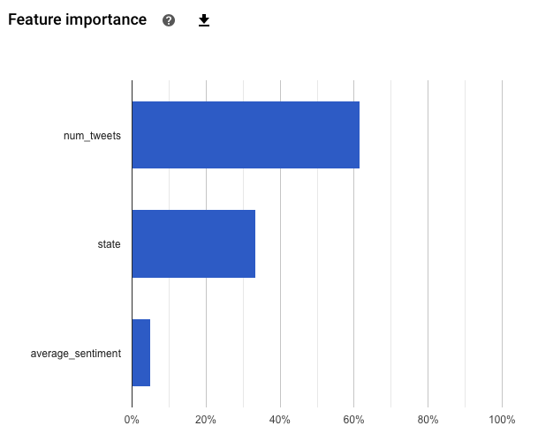
Multiple Runs of the Same Approach
Optimized for | RMSE
MAE | 16.613
RMSE | 30.279
R^2 | 0.495
Optimized for | RMSE
MAE | 468.668
RMSE | 765.386
R^2 | 0.786

Slide 13
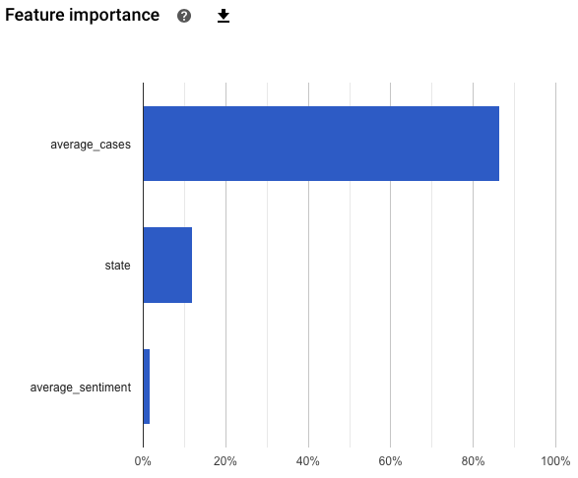
Focusing on Average Cases
Optimized for | RMSE
MAE | 211.680
RMSE | 405.149
R^2 | 0.942

Slide 14
Approach 2: Data Setup

Slide 15
Data Setup: Weekly Data
Cleaned up datasets and compiled data for each WEEK for the following 15 features:
The week, the state and the number of tweets
Average: New Cases, New Deaths, Sentiment,
Favorites, Retweets, New Cases Next Week,
New Deaths Next Week
Total: New Cases, New Deaths, New Cases
Next Week, New Deaths Next Week
Change: In average Cases since last week, In
Average Deaths since last week
We used geotagged COVID tweets from 04/01/20 - 08/31/20 from our dataset
Feature Variables
Week_Num
State
Average_Seniment
Average_New_Cases
Total_New_Cases
Average_New_Deaths
Total_New_Deaths
Average_Favorites
Average_Retweets
Change_in_Average_Cases
Change_in_Average_Deaths
Average_New_Cases_Next_Week
Total_New_Cases_Next_Week
Average_New_Deaths_Next_Week
Total_New_Deaths_Next_Week

Slide 16
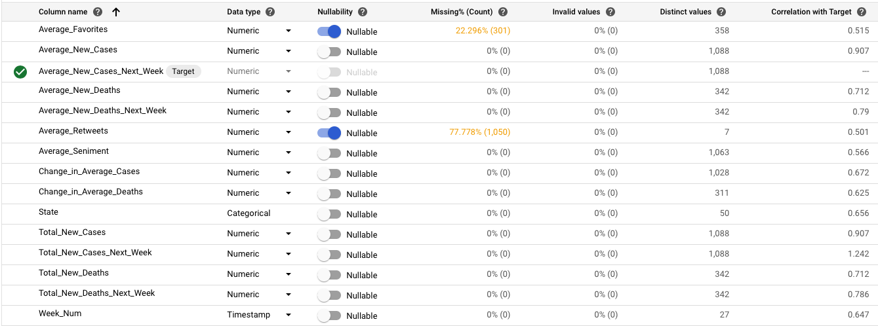
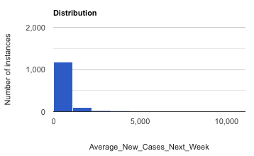
Prediction: Average number of new cases in the next week
Average = 609.57
Median = 242.29
Std = 1230.36

Slide 17
Approach 2: Training Results

Slide 18
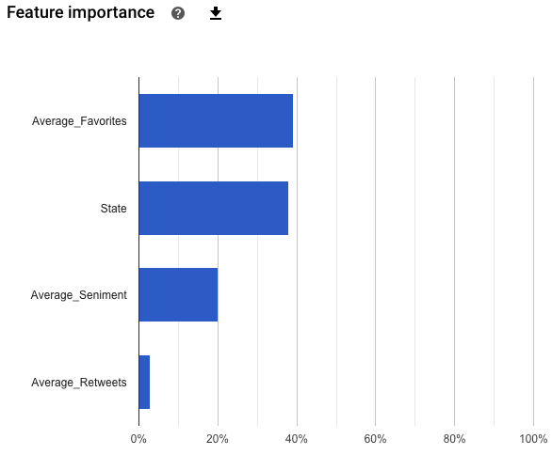
Attempting to Detect Patterns
Optimized for | RMSE
MAE | 450.213
RMSE | 861.151
R^2 | 0.478

Slide 19
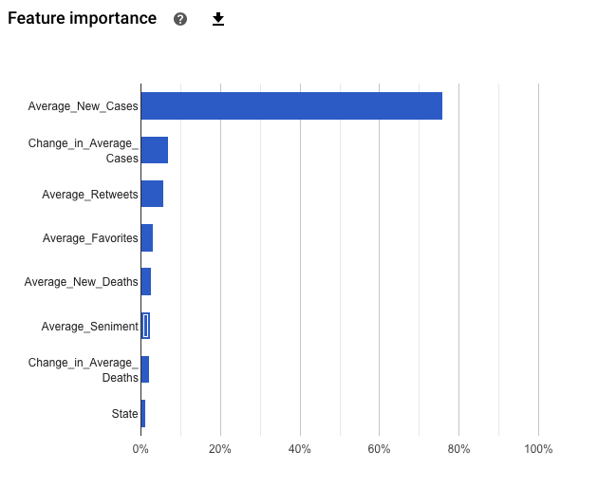
Using Change in Cases
Optimized for | RMSE
MAE | 160.755
RMSE | 332.028
R^2 | 0.923

Slide 20
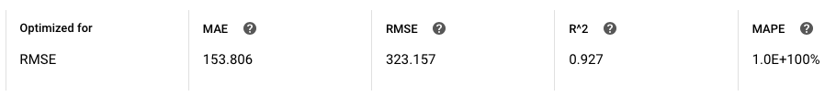
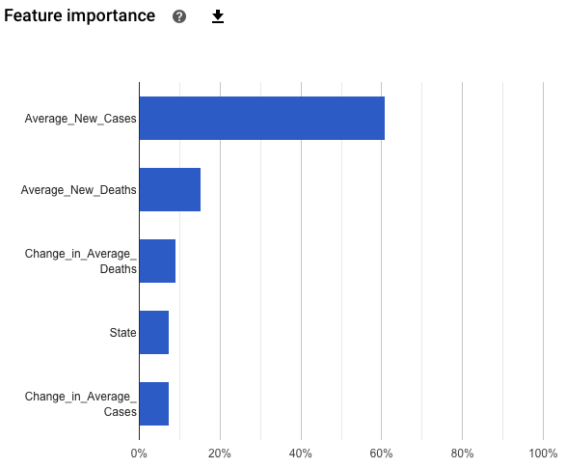
Checking Impact of Tweet Data
Optimized for | RMSE
MAE | 450.213
RMSE | 861.151
R^2 | 0.478

Slide 21
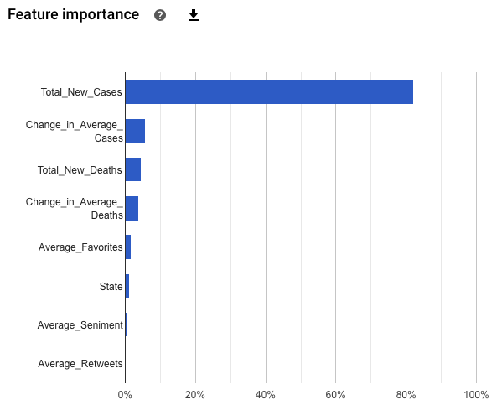
Using Total Cases
Optimized for | RMSE
MAE | 150.574
RMSE | 340.798
R^2 | 0.919

Slide 22
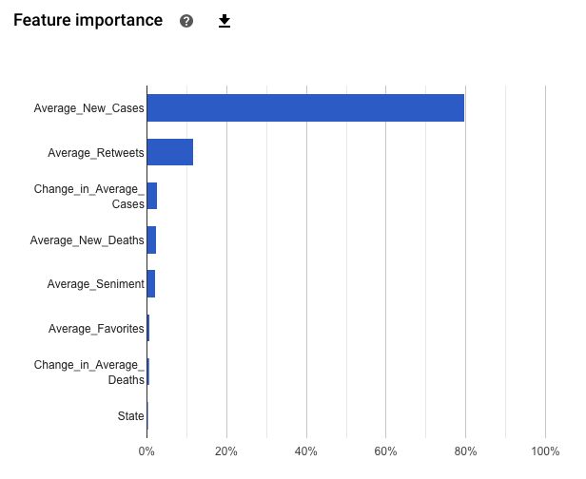
Time based Approach
Optimized for | RMSE
MAE | 416.260
RMSE | 661.429
R^2 | 0.409
Notes:
Time based performed worse

Slide 23
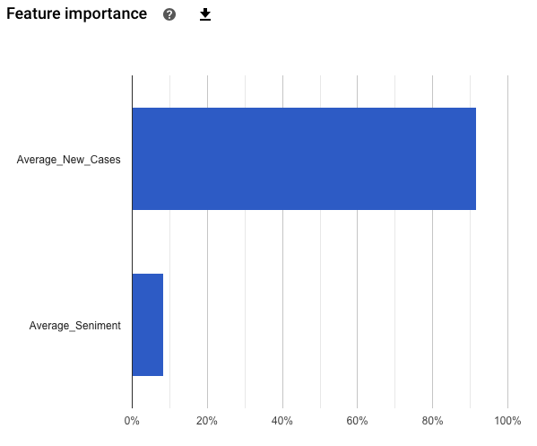
Focusing on Average New Cases
Optimized for | RMSE
MAE | 152.355
RMSE | 308.324
R^2 | 0.934

Slide 24
Application

Slide 25
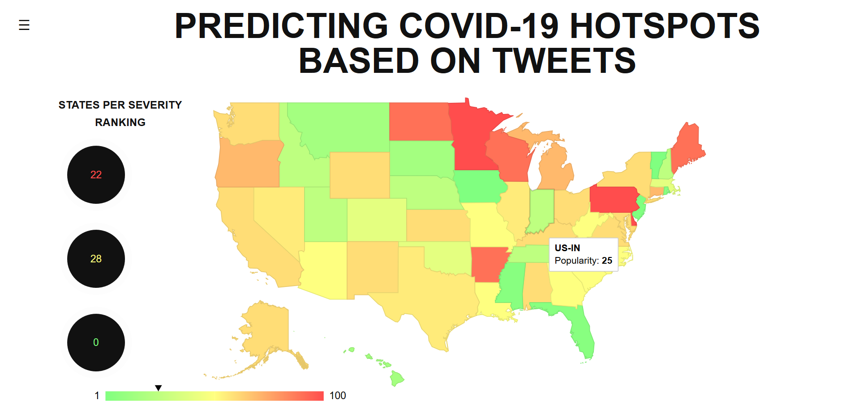
Application: Overview
Python web app
Flask
Google GeoChart API
Integrated tweet scraper and hydrator to get tweets for weekly prediction
Connecting the pipeline
Tweets from hydrator run through model from the Google AutoML Rest API
Prediction set returned and data updated and displayed automatically through the Flask app

Slide 26
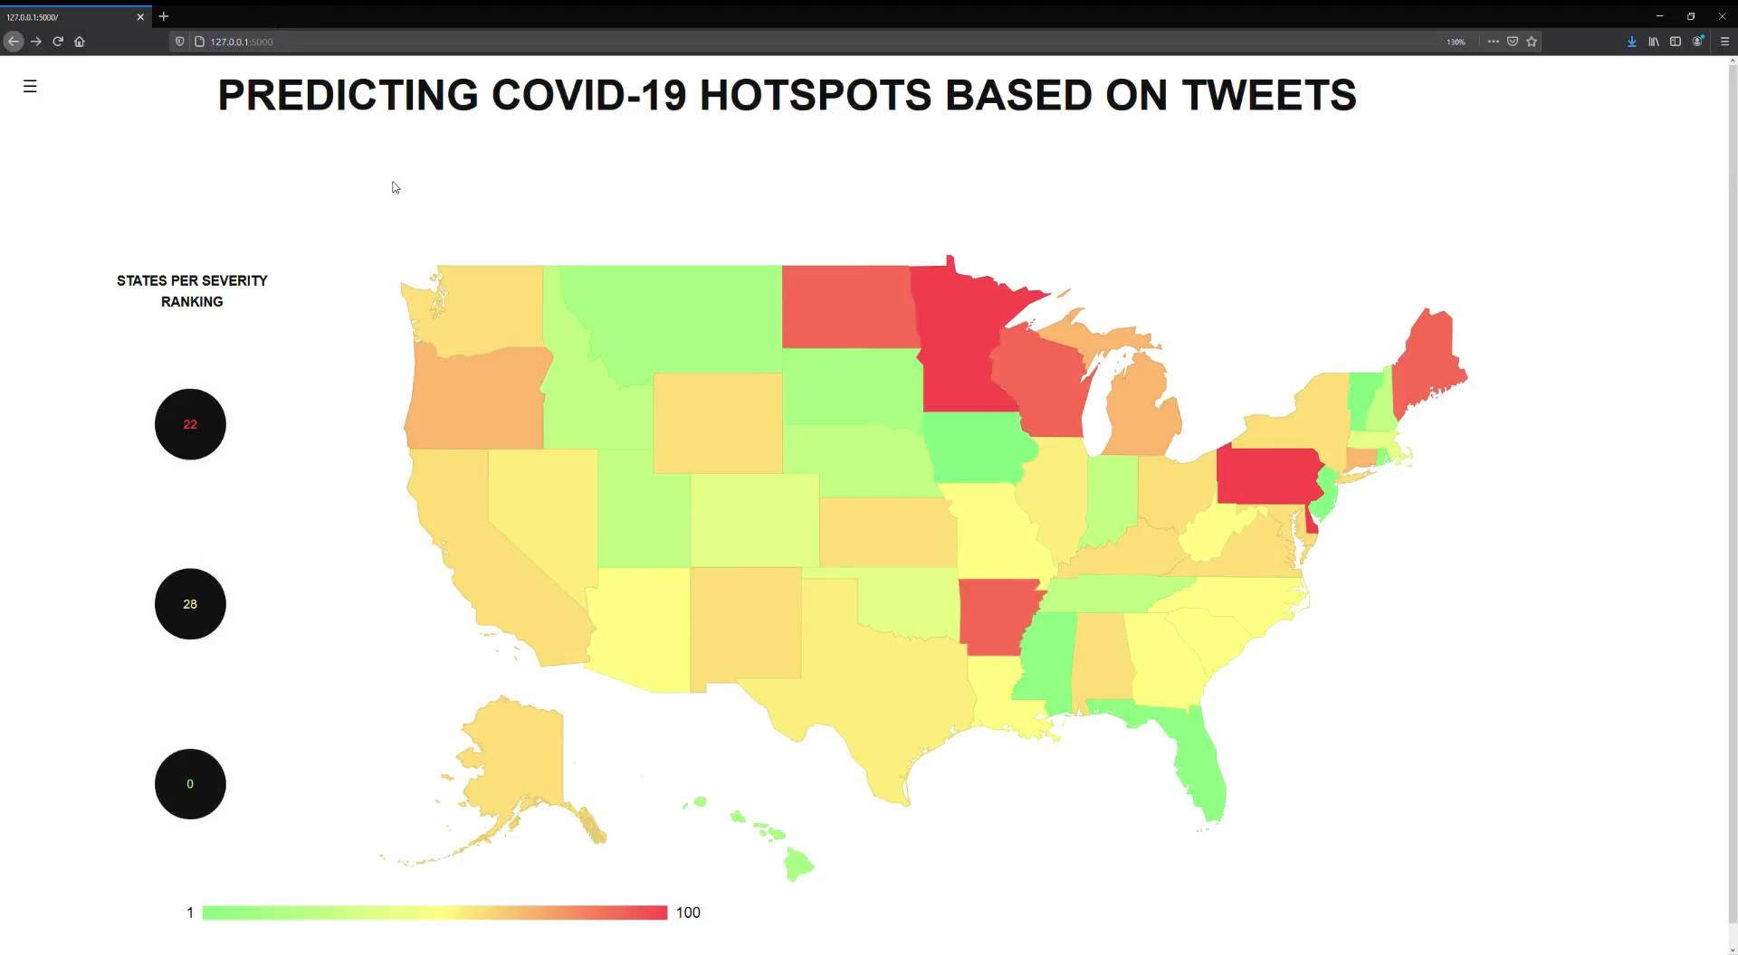

Slide 27
Conclusion & Next Steps

Slide 28
Conclusions & Next Steps
Data Setup & Training Results
Sentiment doesn’t seem to be a good indicator of the number of cases
Favorites play a larger role than sentiment
Move focus away from sentiments
Formulate more metrics based on tweet and COVID case data
Focus on leveraging other NLP data from tweets
Application
Streamline data pipeline to gather and hydrate the previous week’s tweets
Sliding window approach
Extract information from hydrated tweets (e.g. sentiment analysis)
Have our model output predicted COVID cases

Slide 29
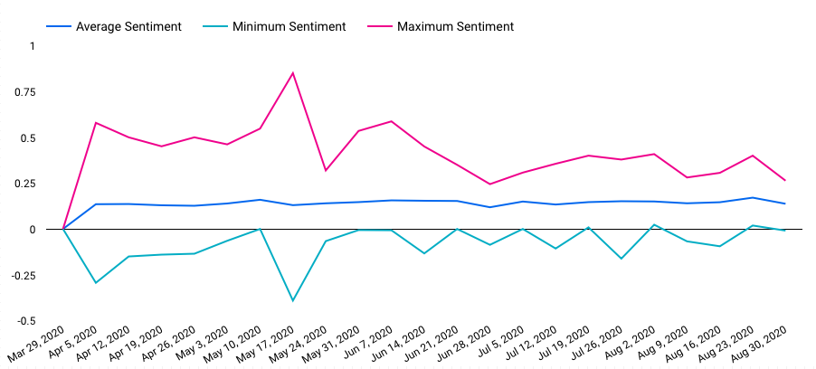
Sentiment Over Time
Notes:
Convert case data into categorial value
Percent of population for each state
Dont predict a contiuous value

